Slide 1
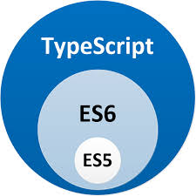
Application Delivery Fundamentals
Parameswari Ettiappan

Slide 2
Typescript
Goals
Introduction to TypeScript
Using Visual Studio Code for TypeScript Development
TypeScript Language Basics
TypeScript Type System
Functional Programming
Object-Oriented Programming
Asynchronous Programming
Generics
Namespaces and Modules
Unit Testing

Slide 3
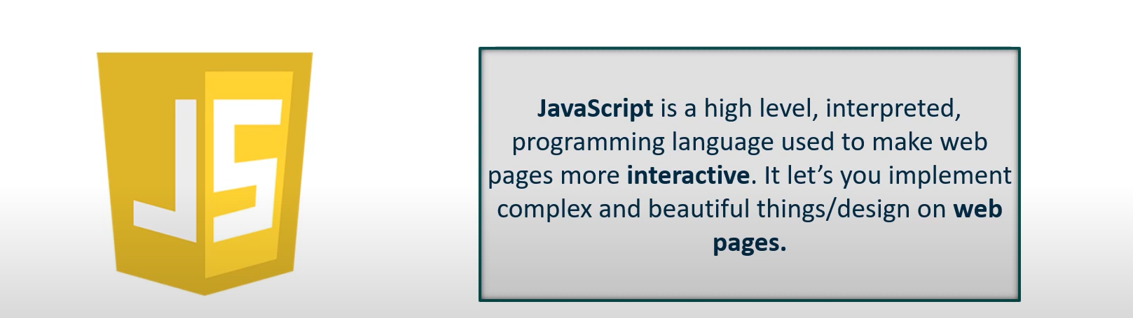

JavaScript

Slide 4
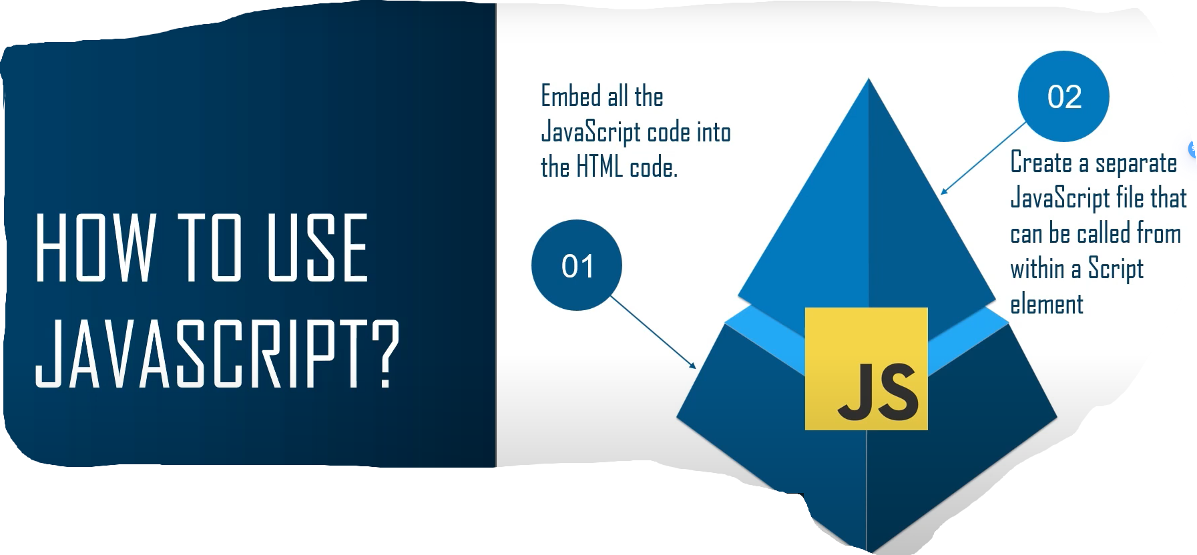
JavaScript

Slide 5
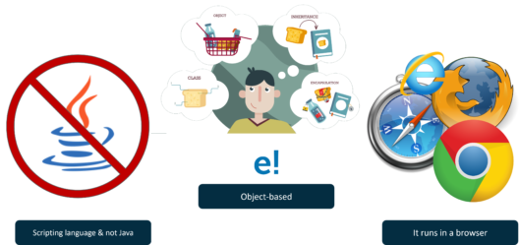
Features of JavaScript

Slide 6
Features of JavaScript
It is a Scripting Language and has nothing to do with Java. Initially, It was named Mocha, then changed to LiveScript and finally it was named as JavaScript.
JavaScript is an object-based programming language that supports polymorphism, encapsulation, and inheritance as well.
You can run JavaScript not only in the browser but also on the server and any device which has a JavaScript Engine.

Slide 7
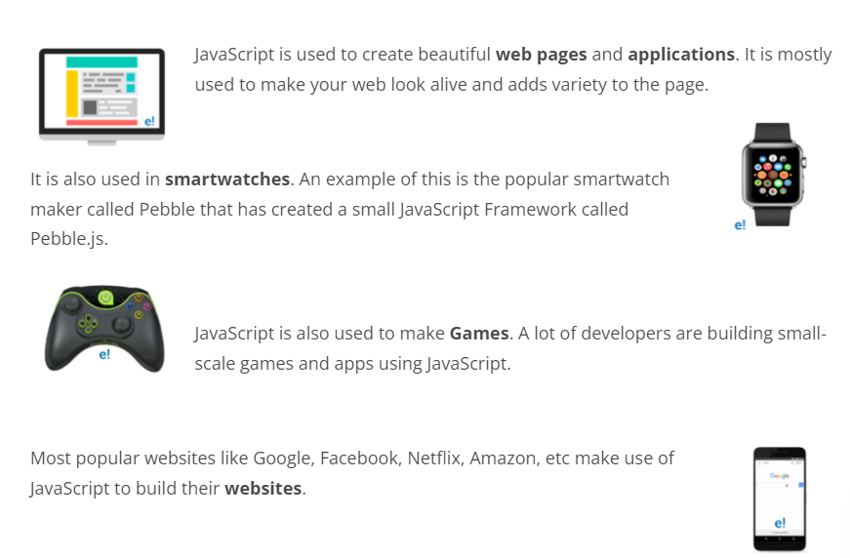
What can JavaScript do?

Slide 8

TypeScript
TypeScript is a typed superset of JavaScript that compiles to plain JavaScript.
TypeScript is pure object-oriented with classes, interfaces and statically typed programming languages like C# or Java.
It requires a compiler to compile and generate in JavaScript file.
Basically, TypeScript is the ES6 version of JavaScript with some additional features.

Slide 9
TypeScript
A TypeScript code is written in a file with .ts extension and then compiled into JavaScript using the compiler.
You can write the file in any code editor and the compiler needs to be installed on your platform.
After the installation, the command tsc <filename>.ts compiles the TypeScript code into a plain JavaScript file.

Slide 10
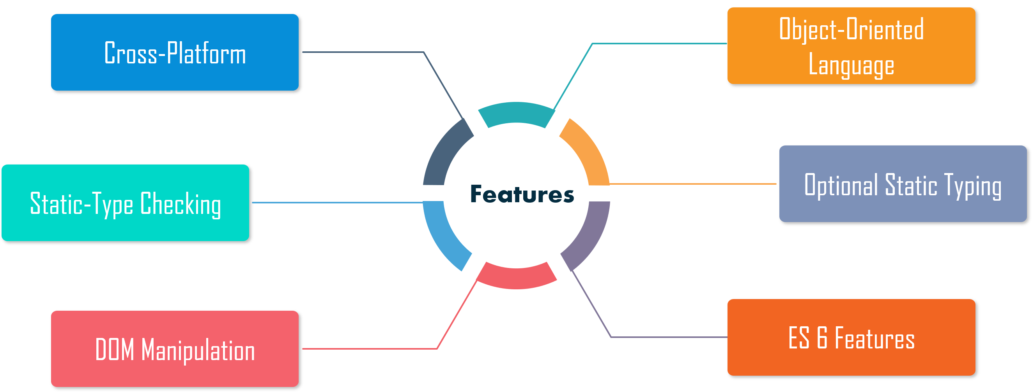
Features of TypeScript

Slide 11
Features of TypeScript
Cross-Platform: The TypeScript compiler can be installed on any Operating System such as Windows, MacOS, and Linux.
Object-Oriented Language: TypeScript provides features like Classes, Interfaces, and Modules. Thus, it can write object-oriented code for client-side as well as server-side development.
Static type-checking: TypeScript uses static typing and helps type checking at compile time. Thus, you can find errors while writing the code without running the script.
Optional Static Typing: TypeScript also allows optional static typing in case you are using the dynamic typing of JavaScript.
DOM Manipulation: You can use TypeScript to manipulate the DOM for adding or removing elements.
ES 6 Features: TypeScript includes most features of planned ECMAScript 2015 (ES 6, 7) such as class, interface, Arrow functions, etc.

Slide 12
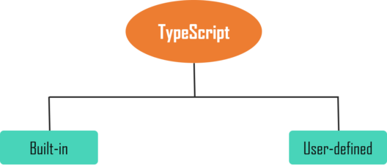
Types of TypeScript
It can be classified into two types such as:
Built-in: This includes number, string, boolean, void, null and undefined.
User-defined: It includes Enumerations (enums), classes, interfaces, arrays, and tuple.

Slide 13
How to install TypeScript
There are two main ways to install TypeScript tools such as:
Via npm (Node.js Package Manager) command-line tool
npm install -g typescript
By installing TypeScript via Visual Studio.
If you use Visual Studio or VS Code IDE, the easiest way to add to Visual Studio or VS Code is to search and add a package or download from the TypeScript website.
Also, you can download TypeScript Tools for Visual Studio.

Slide 14
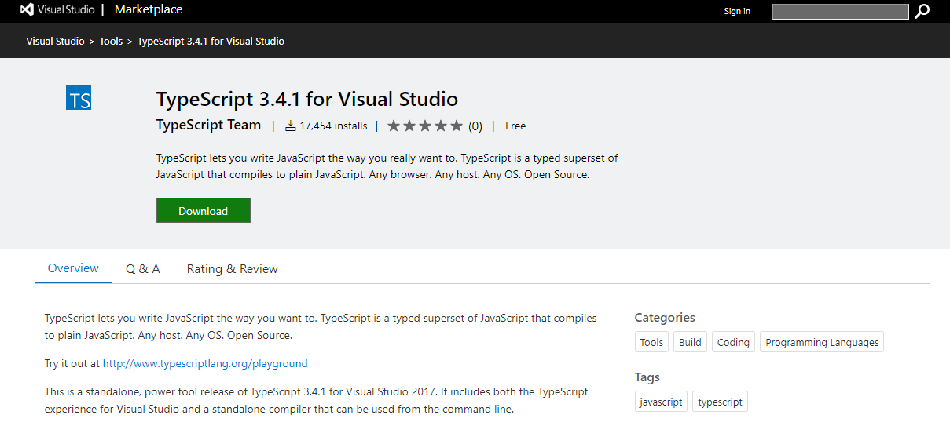
How to install TypeScript

Slide 15
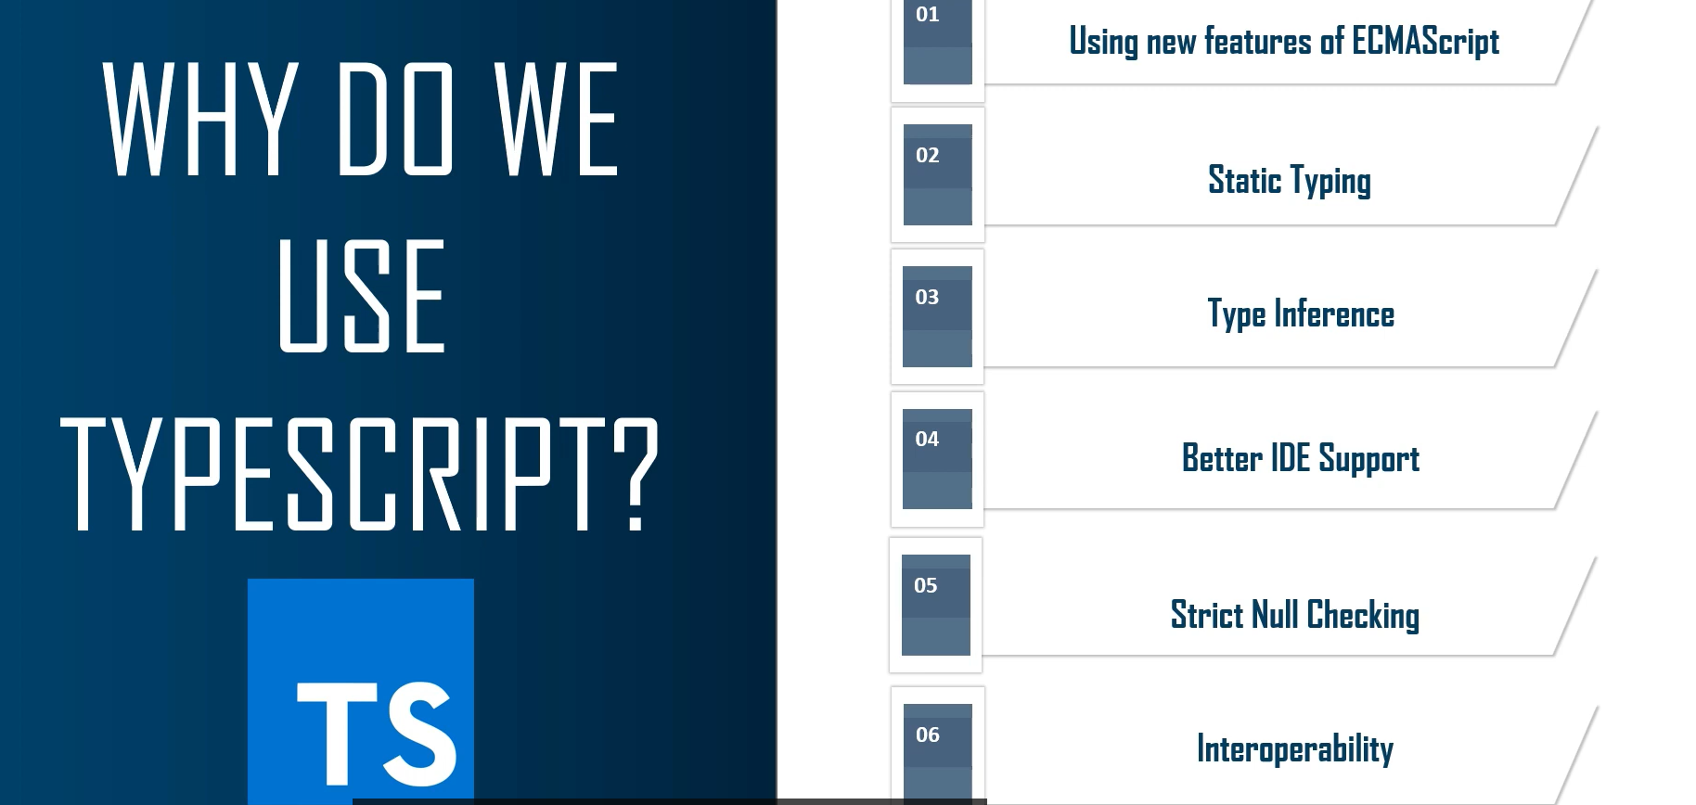
Why do we useTypeScript

Slide 16
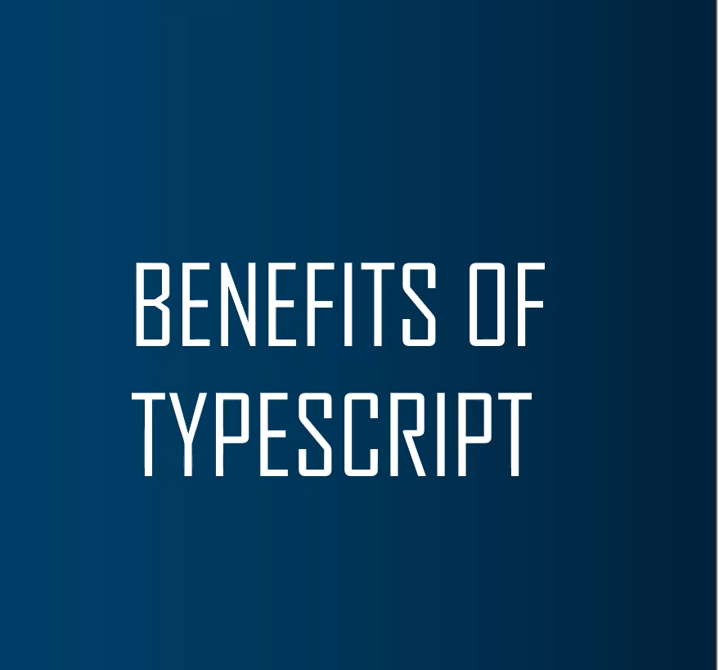
Why do we useTypeScript
TypeScript is fast, simple, easy to learn and runs on any browser or JavaScript engine.
It is similar to JavaScript and uses the same syntax and semantics.
This helps backend developers write front-end code faster.
You can call the TypeScript code from an existing JavaScript code.
Also, it works with existing JavaScript frameworks and libraries without any issues.
The Definition file, with .d.ts extension, provides support for existing JavaScript libraries like Jquery, D3.js, etc.
So, TypeScript code can add JavaScript libraries using type definitions to avail the benefits of type-checking, code autocompletion, and documentation in existing dynamically-typed JavaScript libraries.
It includes features from ES6 and ES7 that can run in ES5-level JavaScript engines like Node.js.

Slide 17
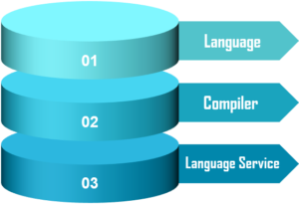
Components of TypeScript

Slide 18
Components of TypeScript
Language − It comprises of the syntax, keywords, and type annotations.
The TypeScript Compiler − This compiler (tsc) converts the instructions written in TypeScript to its JavaScript equivalent.
The TypeScript Language Service − The Language Service exposes an additional layer around the core compiler pipeline, editor-like applications. The language service supports the common set of typical editor operations.

Slide 19
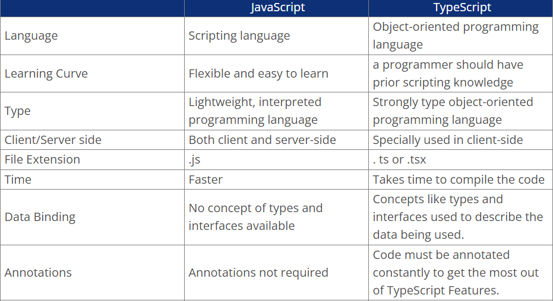
TypeScript vs JavaScript

Slide 20
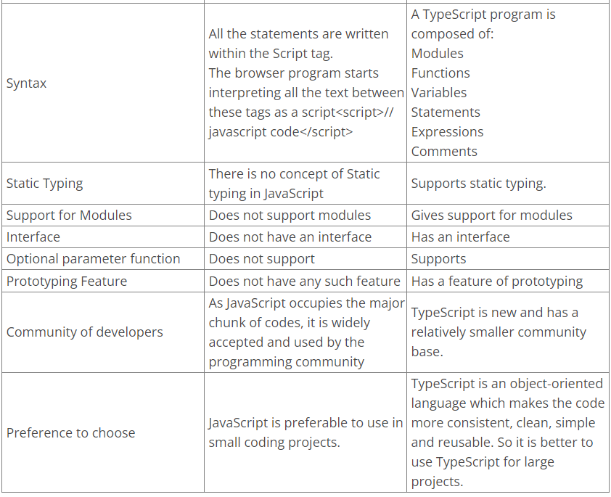
TypeScript vs JavaScript

Slide 21
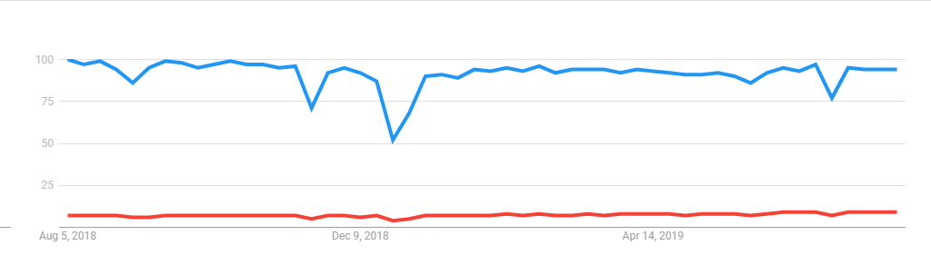
TypeScript Trends

Slide 22
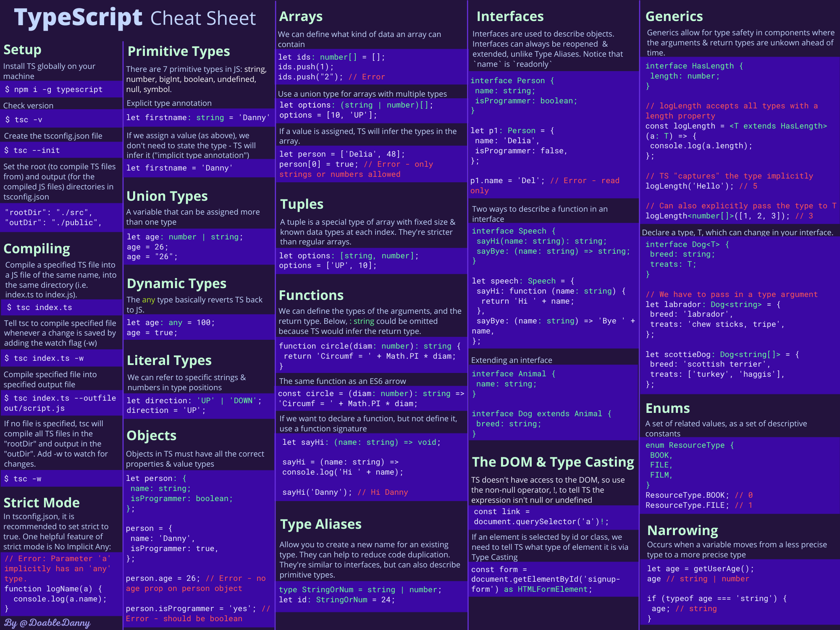
Typescript

Slide 23
Bit of History
Version number | Release date | Significant changes
0.8 | October 1, 2012
0.9 | June 18, 2013
1.1 | October 6, 2014 | performance improvements
1.3 | November 12, 2014 | protected modifier, tuple types
1.4 | January 20, 2015 | union types, let and const declarations, template strings, type guards, type aliases
1.5 | July 20, 2015 | ES6 modules, namespace keyword, for..of support, decorators
1.6 | September 16, 2015 | JSX support, intersection types, local type declarations, abstract classes and methods, user-defined type guard functions

Slide 24
Bit of History
1.7 | November 30, 2015 | async and await support,
1.8 | February 22, 2016 | constraints generics, control flow analysis errors, string literal types, allowJs
2.0 | September 22, 2016 | null- and undefined-aware types, control flow based type analysis, discriminated union types, never type, readonly keyword, type of this for functions
2.1 | November 8, 2016 | keyof and lookup types, mapped types, object spread and rest,
2.2 | February 22, 2017 | mix-in classes, object type,
2.3 | April 27, 2017 | async iteration, generic parameter defaults, strict option
2.4 | June 27, 2017 | dynamic import expressions, string enums, improved inference for generics, strict contravariance for callback parameters
2.5 | August 31, 2017 | optional catch clause variables

Slide 25
Bit of History
2.6 | October 31, 2017 | strict function types
2.7 | January 31, 2018 | constant-named properties, fixed length tuples
2.8 | March 27, 2018 | conditional types, improved keyof with intersection types
2.9 | May 14, 2018 | support for symbols and numeric literals in keyof and mapped object types
3.0 | July 30, 2018 | project references, extracting and spreading parameter lists with tuples
3.1 | September 27, 2018 | mappable tuple and array types
3.2 | November 30, 2018 | stricter checking for bind, call, and apply

Slide 26
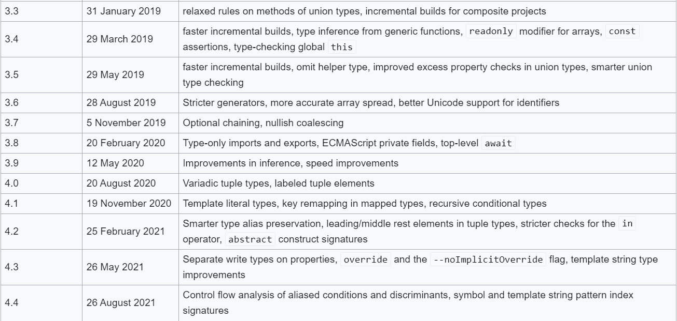
Bit of History

Slide 27
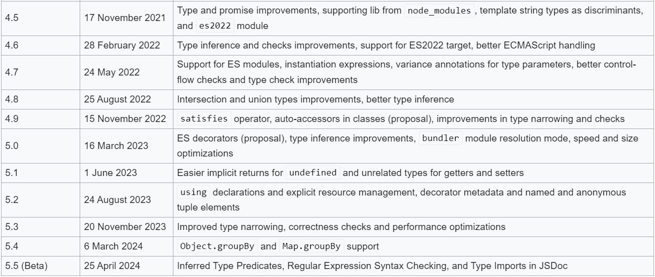
Bit of History

Slide 28
Type Script in 5 minutes
Installing Type Script
There are two main ways to get the Type Script tools:
Via npm (the Node.js package manager)
By installing TypeScript’s Visual Studio plugins
> npm install -g typescript

Slide 29
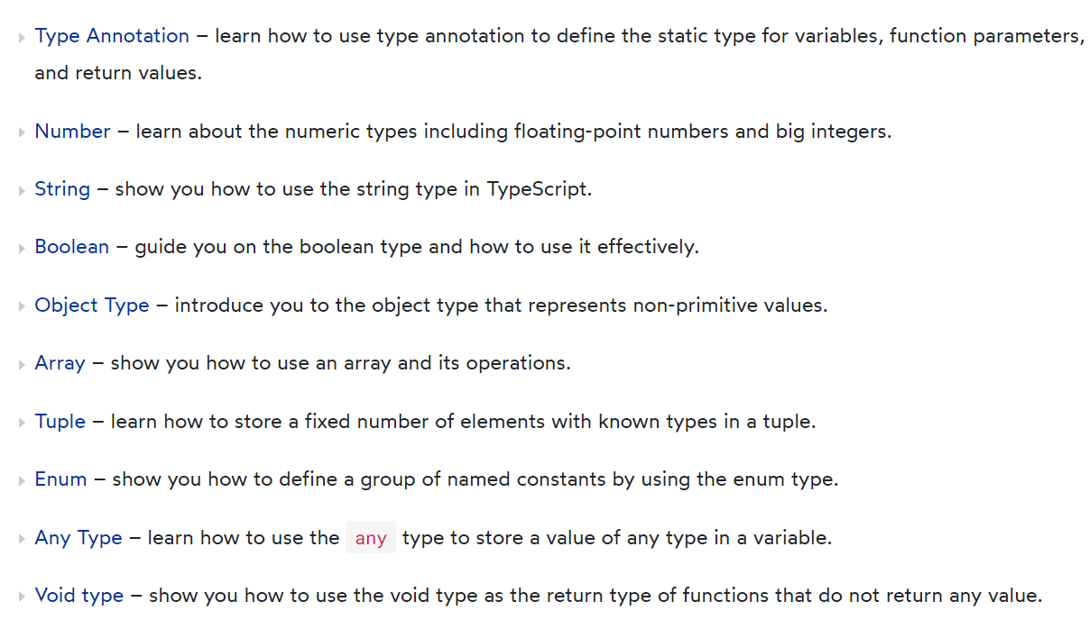
TypeScript Basic Types

Slide 30
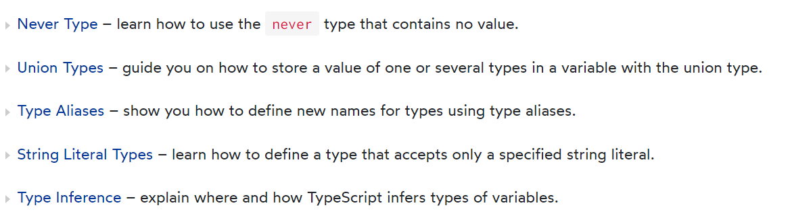
TypeScript Basic Types

Slide 31
What is Type Annotation in TypeScript
TypeScript uses type annotations to explicitly specify types for identifiers such as variables, functions, objects, etc.
TypeScript uses the syntax : type after an identifier as the type annotation, which type can be any valid type.
Once an identifier is annotated with a type, it can be used as that type only.
If the identifier is used as a different type, the TypeScript compiler will issue an error.

Slide 32
What is Type Annotation in TypeScript
TypeScript uses type annotations to explicitly specify types for identifiers such as variables, functions, objects, etc.
TypeScript uses the syntax : type after an identifier as the type annotation, which type can be any valid type.
Once an identifier is annotated with a type, it can be used as that type only.
If the identifier is used as a different type, the TypeScript compiler will issue an error.

Slide 33
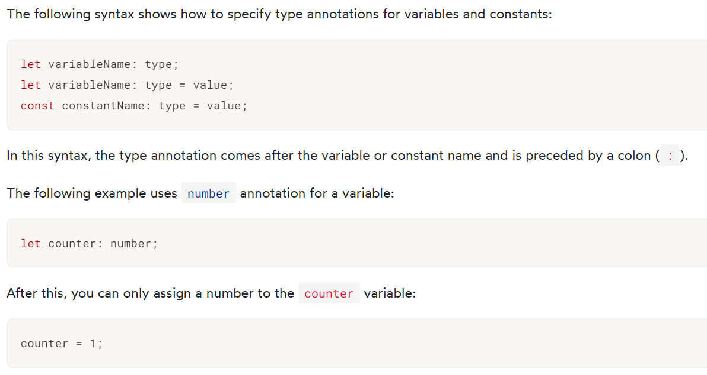
Type annotations in variables and constants

Slide 34
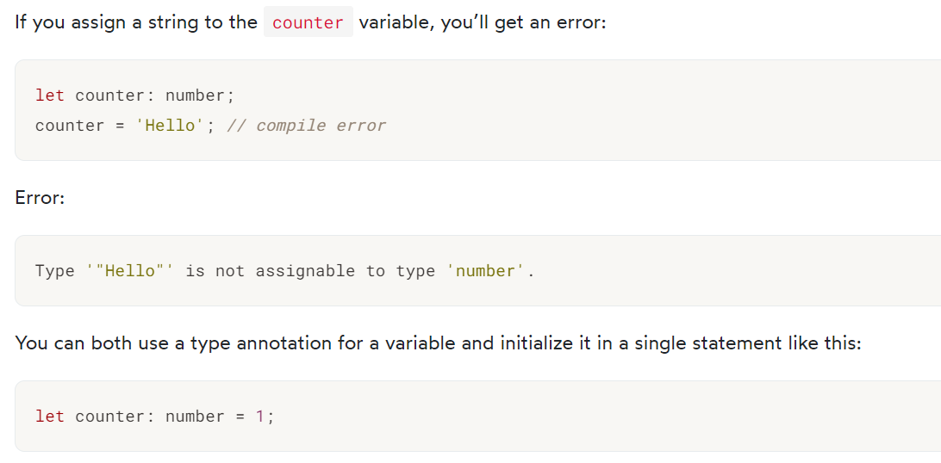
Type annotations in variables and constants

Slide 35
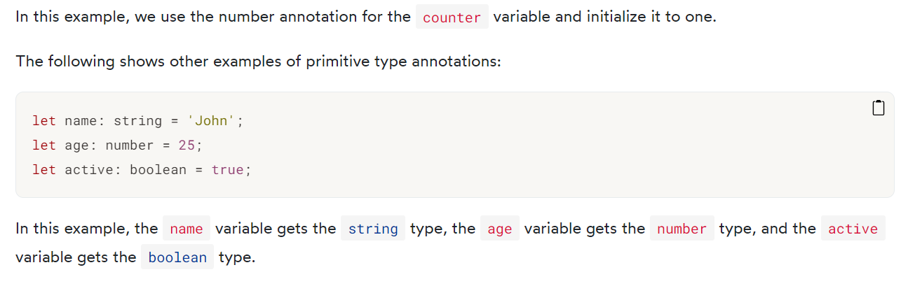
Type annotations in variables and constants

Slide 36
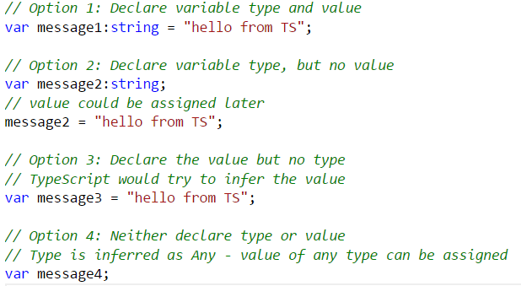
Type Inference
Four ways of variable declaration -
Declare its type and value (as a literal) in one statement.
Declare its type but no value. The value will be set to undefined.
Declare its value but no type. The variable will be of type Any (that is, an old-school dynamic JavaScript variable), but its type may be inferred based on its value.
Declare neither value nor type. The variable will be of type Any, and its value will be undefined.

Slide 37
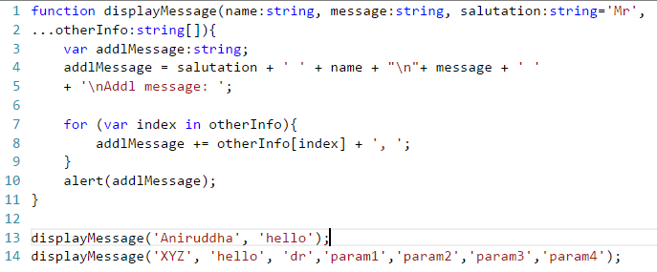
Array
var cities:string[] = ["Berlin","Bangalore","New York"]
var primes:number[] = [1,3,5,7,11,13]
var bools:boolean[] = [true,false,false,true]

Slide 38
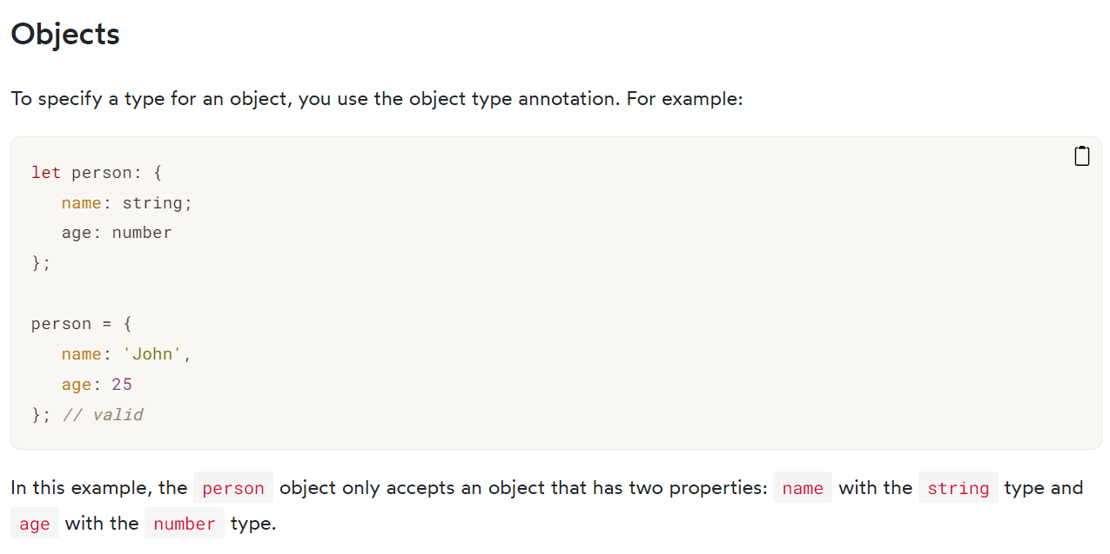
Objects

Slide 39
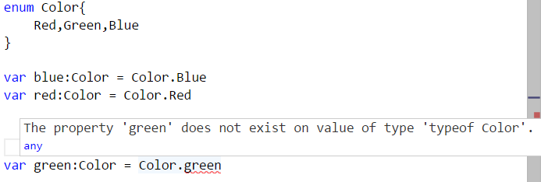
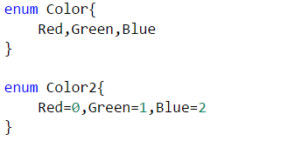
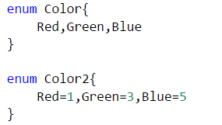
Enum
Addition to JavaScript datatypes. Similar to C# enum
Like languages like C#, an enum is a way of giving more friendly names to sets of numeric values.
By default, enums begin numbering their members starting at 0. You can change this by manually setting the value of one its members.

Slide 40
Any
Useful to describe the type of variables that we may not know when we are writing the application.
May come from dynamic content, eg from the user or 3rd party library.
Allows to opt-out of type-checking and let the values pass through compile-time checks.
Same as not declaring any datatype – uses JavaScript’s dynamic nature
var notSure: any
var list:any[] = [1, true, "free"]
list[1] = 100

Slide 41
Void
Perhaps the opposite in some ways to 'any' is 'void',
the absence of having any type at all.
Commonly used as the return type of functions that do not return a value
function warnUser(): void {
alert("This is my warning message");
}

Slide 42
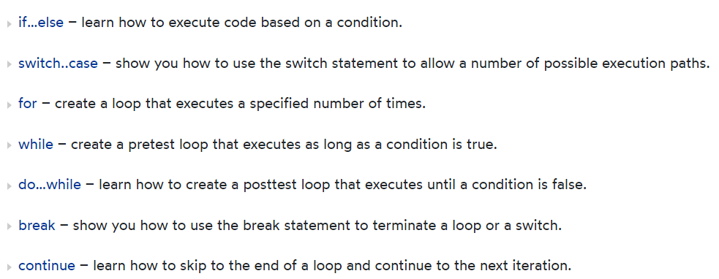
Control Flow Statements

Slide 43
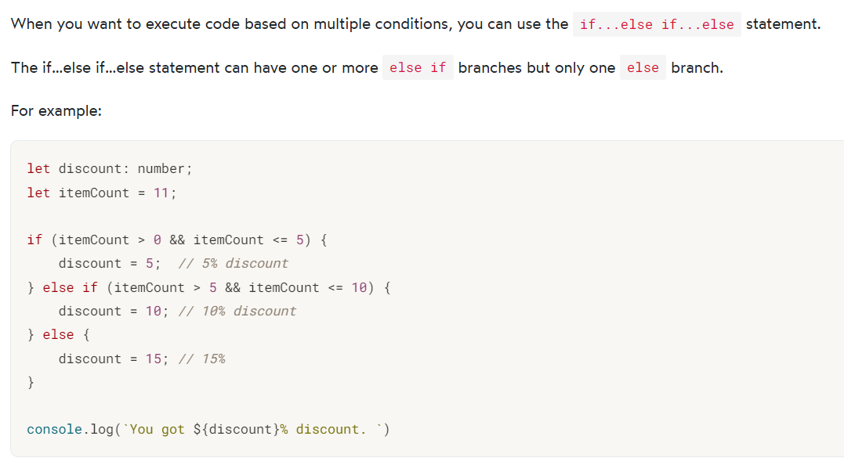
TypeScript If elseif else

Slide 44
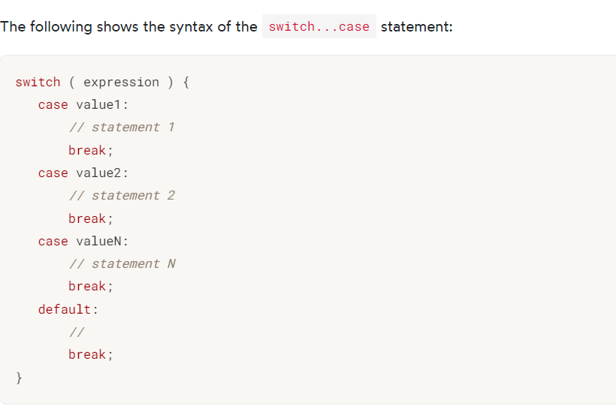
TypeScript Switch Case

Slide 45
Function

Slide 46
Function Overview
Functions are the fundamental building block of any applications in JavaScript.
JavaScript is a functional programming language, and so supports first class functions.
Allows build up layers of abstraction, mimicking classes, information hiding, and modules (JavaScript does not support class, module, private members).
In TypeScript, while there are classes and modules, function still play the key role in describing how to 'do' things.

Slide 47
Function Overview
TypeScript adds some new capabilities to the standard JavaScript functions to make them easier to work with.
Type Annotation for parameter and return type
Optional and Default Parameter
Rest Parameter
Function Overloads

Slide 48
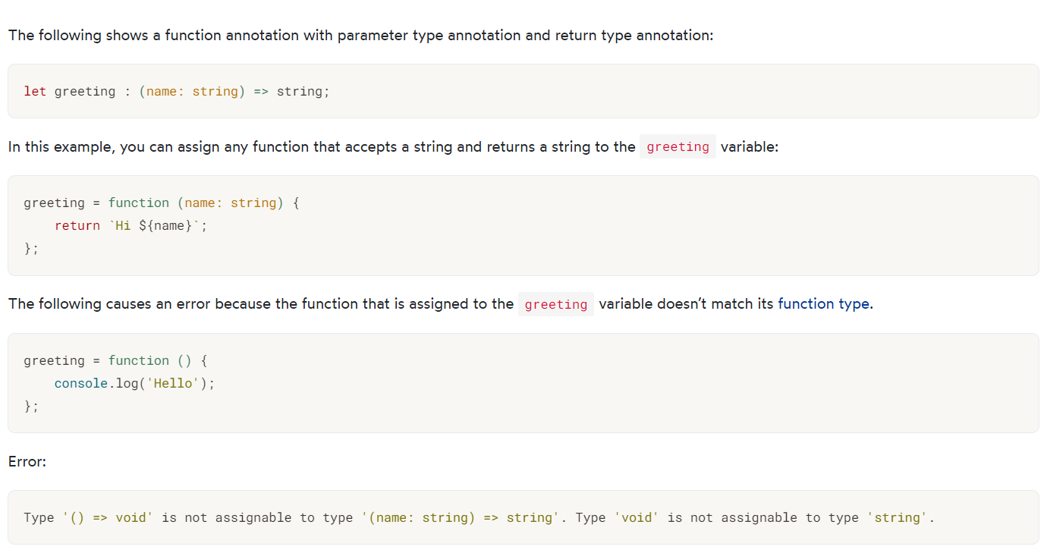
Function Arguments and Return Types

Slide 49
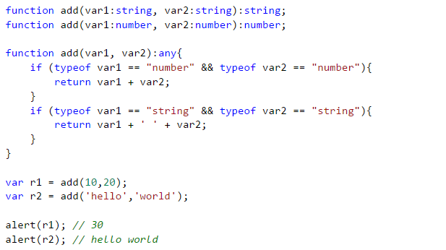
Function Overloads

Slide 50
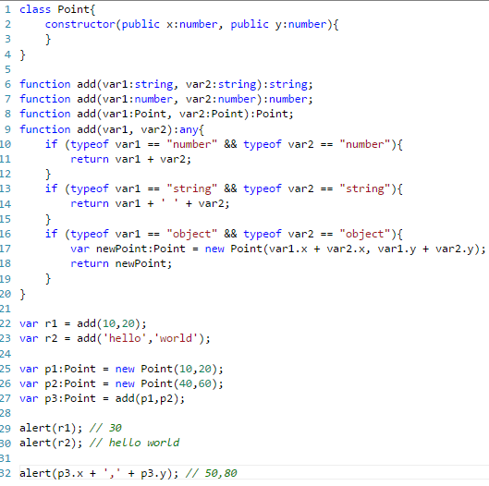
Function Overloads (2)

Slide 51
Optional & Default Parameter
In JavaScript, you can call a function without passing any arguments even though the function specifies parameters.
Therefore, JaveScript supports the optional parameters by default.
In TypeScript, the compiler checks every function call and issues an error in the following cases:
The number of arguments is different from the number of parameters specified in the function.
Or the types of arguments are not compatible with the types of function parameters.
Because the compiler thoroughly checks the passing arguments, you need to annotate optional parameters to instruct the compiler not to issue an error when you omit the arguments.

Slide 52
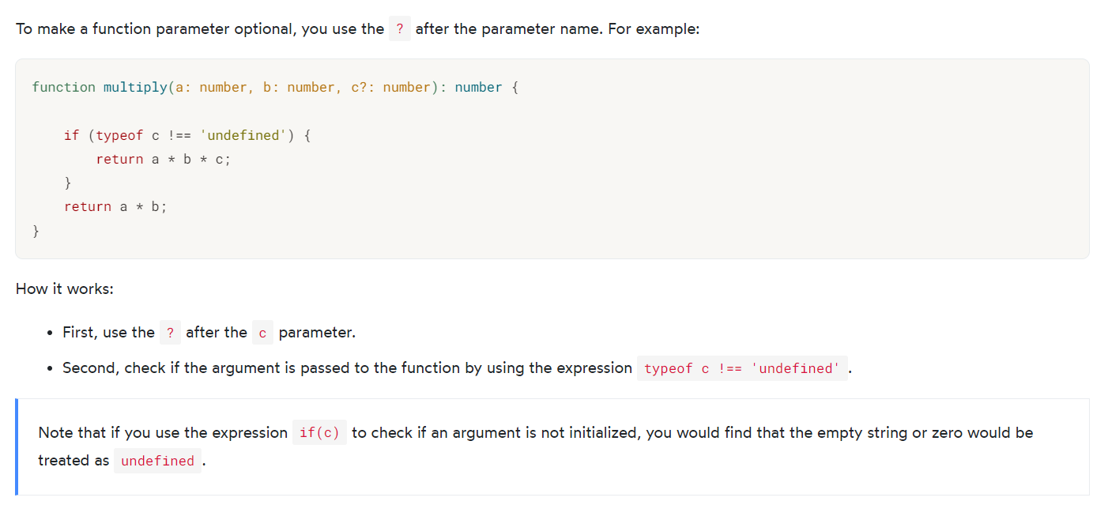
Optional & Default Parameter

Slide 53
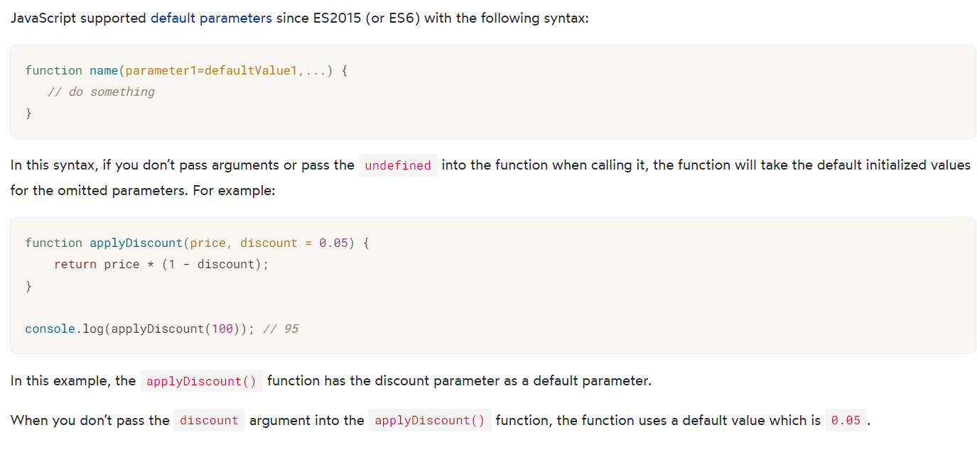
Optional & Default Parameter

Slide 54
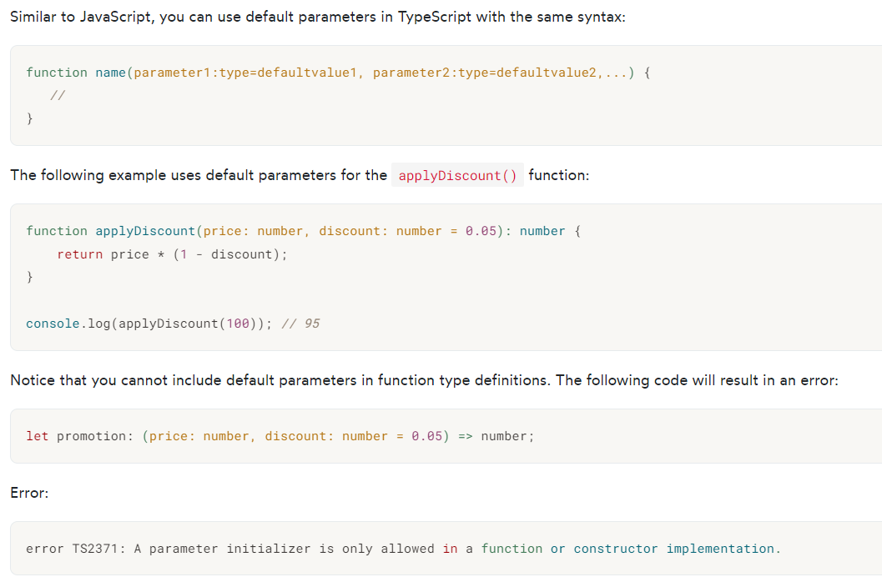
Optional & Default Parameter

Slide 55
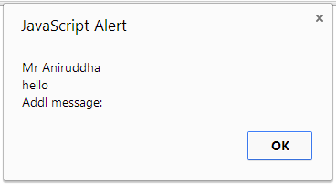
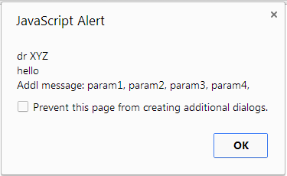
Rest Parameter
Declared as … paramName:[paramType]

Slide 56
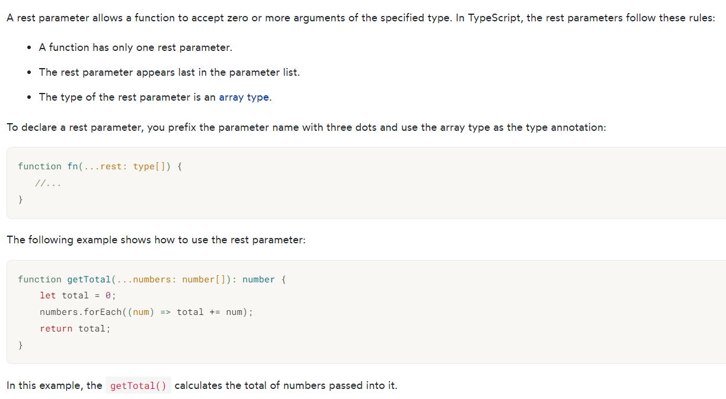
TypeScript Rest Parameters

Slide 57
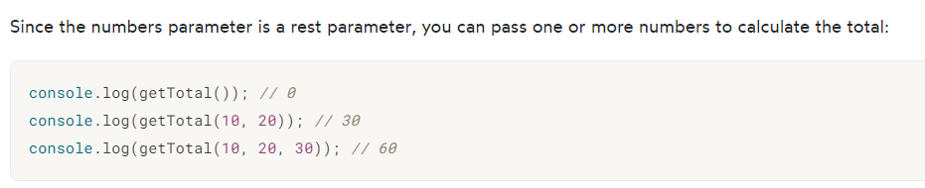
TypeScript Rest Parameters

Slide 58
Class

Slide 59
Class
Properties and fields to store data
Methods to define behavior
Events to provide interactions between different objects and classes

Slide 60
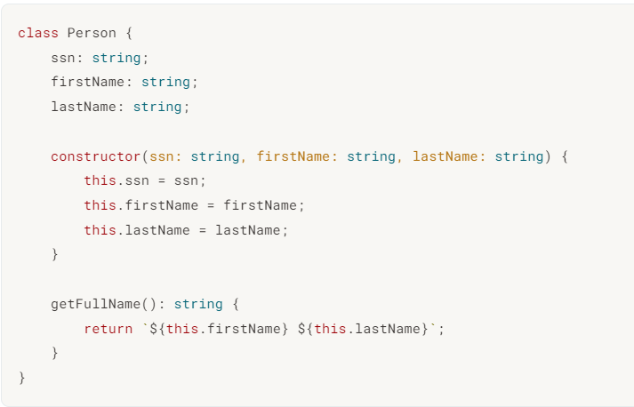
Field and Property

Slide 61
TypeScript Access Modifiers
Access modifiers change the visibility of the properties and methods of a class. TypeScript provides three access modifiers:
private
protected
public
Note that TypeScript controls the access logically during compilation time, not at runtime.

Slide 62
Private Access Modifiers
The private modifier
The private modifier limits the visibility to the same class only.
When you add the private modifier to a property or method, you can access that property or method within the same class.
Any attempt to access private properties or methods outside the class will result in an error at compile time.
The following example shows how to use the private modifier to the snn, firstName, and lastName properties of the person class:

Slide 63
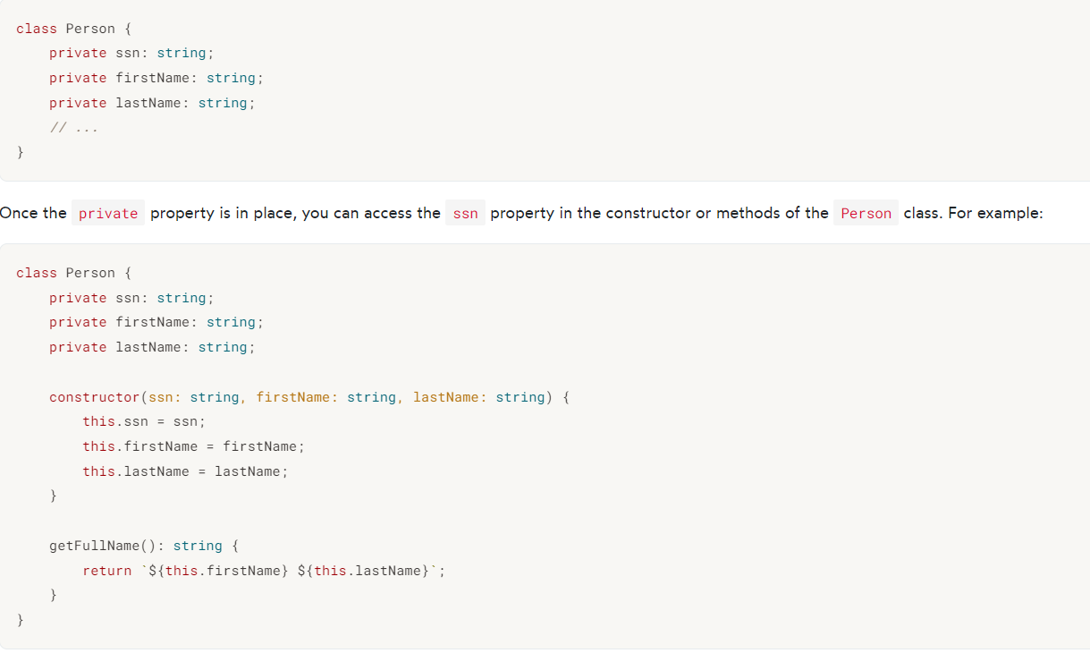
Private Access Modifiers

Slide 64
Public Access Modifiers
The public modifier allows class properties and methods to be accessible from all locations.
If you don’t specify any access modifier for properties and methods, they will take the public modifier by default.
For example, the getFullName() method of the Person class has the public modifier.
The following explicitly adds the public modifier to the getFullName() method:

Slide 65
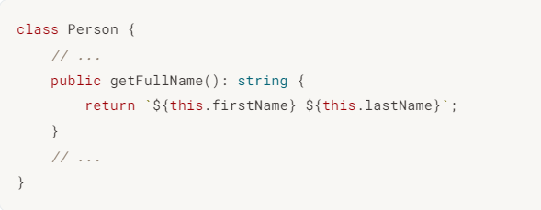
Public Access Modifiers

Slide 66
The protected modifier
The protected modifier allows properties and methods of a class to be accessible within the same class and within subclasses.
When a class (child class) inherits from another class (parent class), it is a subclass of the parent class.
The TypeScript compiler will issue an error if you attempt to access the protected properties or methods from anywhere else.

Slide 67
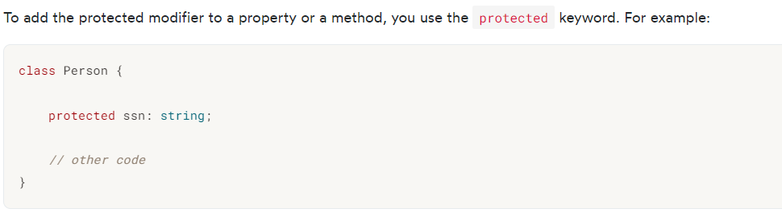
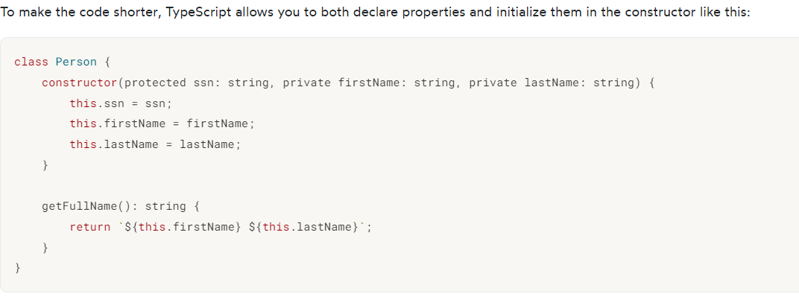
The protected modifier

Slide 68
TypeScript readonly
TypeScript provides the readonly modifier that allows you to mark the properties of a class immutable.
The assignment to a readonly property can only occur in one of two places:
In the property declaration.
In the constructor of the same class.

Slide 69
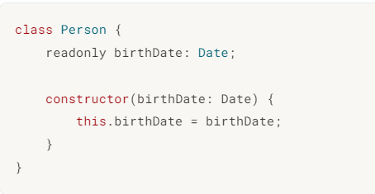
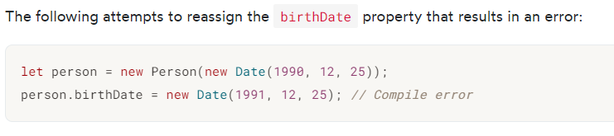
TypeScript readonly

Slide 70
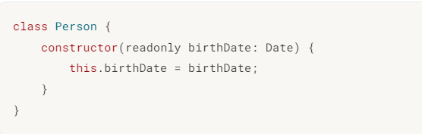
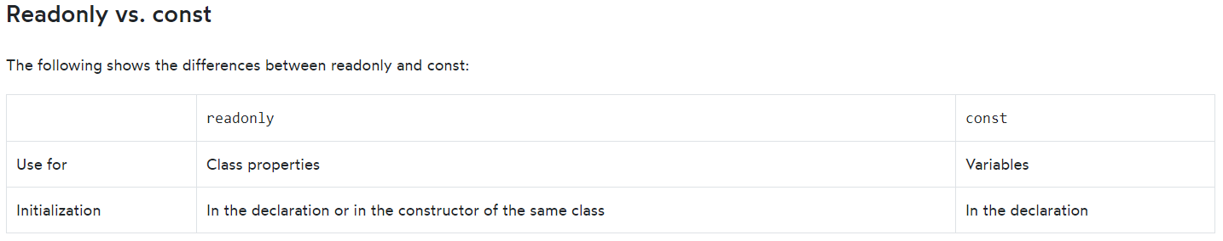
TypeScript readonly

Slide 71

Constructor
Uses constructor keyword
public by default, can not be private

Slide 72


Constructor shortcut

Slide 73



Events

Slide 74


Access Modifiers
public (default) - member is available to all code in another module.
private - member is available only to other code in the same assembly.

Slide 75

Static Methods
TypeScript supports static members (methods)
static methods are visible on the class itself rather than on the instances

Slide 76

Class

Slide 77


JavaScript Constructor Pattern

Slide 78

JavaScript Constructor Pattern (2)

Slide 79

Class – TypeScript uses same Constructor Pattern

Slide 80

Inheritance
TypeScript supports inheritance of class through extends keyword

Slide 81
Module

Slide 82

Module
Modules can be defines using module keyword
A module can contain sub module, class, interface or enum. Can not directly contain functions (similar to C#, Java)
Modules can be nested (sub module)
Class, Interfaces can be exposed using export keyword

Slide 83
Interface

Slide 84


Interface
Declared using interface keyword
Like many other TypeScript feature it’s purely a Design time feature. No additional code is emitted for this!
TS compiler shows error when Interface signature and implementation does not match

Slide 85


Interface (Cont’d)

Slide 86

Optional Property
Optional properties can be declared for an interface (using ?)
Optional properties need not be implemented

Slide 87

Interface

Slide 88
Mixin

Slide 89
Mixin
In object-oriented programming languages, a mixin is a class which contains a combination of methods from other classes.
Along with traditional OO hierarchies, another popular way of building up classes from reusable components is to build them by combining simpler partial classes – called Mixin
Several languages support Mixin (e.g. Trait in PHP and Scala).
This pattern in popular in JavaScript community, so TypeScript provides language support.

Slide 90

Mixins
Programmer
Manager
Person
Employee

Slide 91



Mixins (Cont’d)

Slide 92

Mixins (Cont’d)

Slide 93
JavaScript gochas (not fixed in TS)
TypeScript does not introduce block scope (JavaScript only supports function scope)
; is still optional in TypeScript also (; is not mandatory in JavaScript and it tries to infer ; and sometime does it differently than expected)
== vs === (and != vs !==)
== checks for value equality only
=== checks for both type and value equality
global variables (variables declared outside of function), implied global (variables declared within function without var keyword)
issues with floating point (.1 + .2 != .3, it’s something like .3000…00004)

Slide 94
Questions

